Slide 1
STUDENTS ATTENDANCE USING FACE RECOGNITION
By
S.Harish
C.M.Kabilesh

Slide 2
OUTLINE
ABSTRACT
INTRODUCTION
EXISTING METHOD
CONSTRUCTION
WORKING
APPLICATION
FUTURE SCOPE

Slide 3
ABSTRACT
Face recognition is among the most productive image processing applications and has a pivotal role in the technical field
Recognition of the human face is an active issue for authentication purposes specifically in the context of attendance of students

Slide 4
INTRODUCTION
A procedure of recognizing students by using face biostatistics based on the high definition monitoring and other computer technologies
OpenCV ia an open-sourced image processing library that is very widely used not just in industry but also in the field of research and development

Slide 5
EXISTING METHOD
The attendance through a high-resolution digital camera that detects and recognizes the faces of the students.
The machine compares the recognized face with students’ face images stored in the database.
Once the face of the student is matched with the stored image, then the attendance is marked in attendance database for further calculation

Slide 6
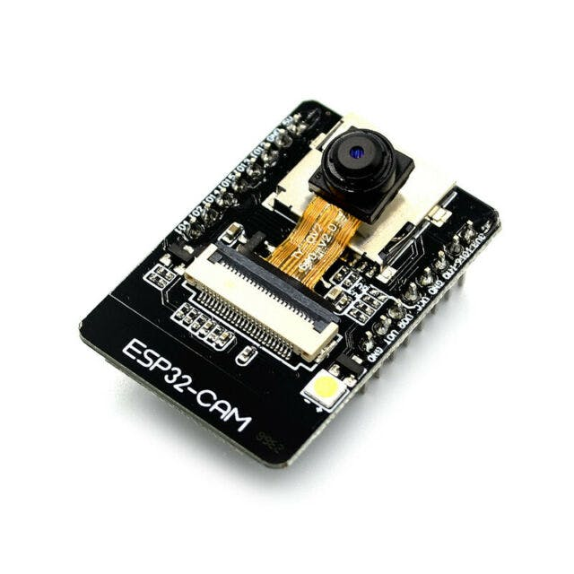
CONSTRUCTION
What is this?
It is a wireless image transmiting module

Slide 7
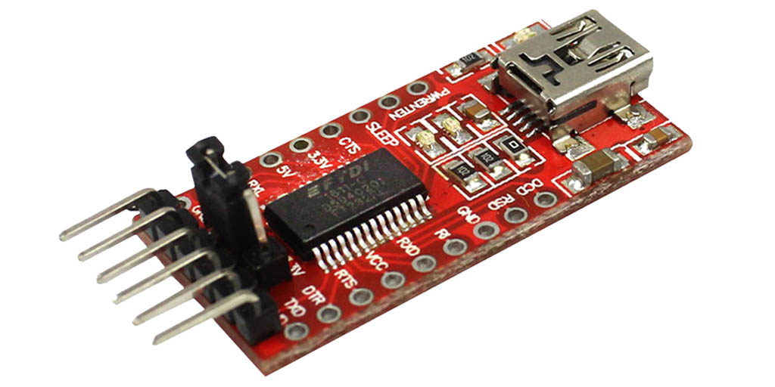
What is this?
It is a fully integrated USB terminator

Slide 8
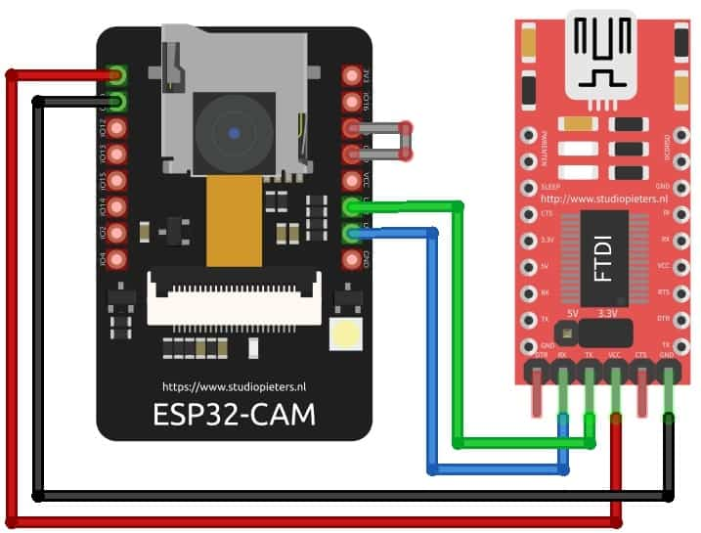
WORKING
Block Diagram

Slide 9
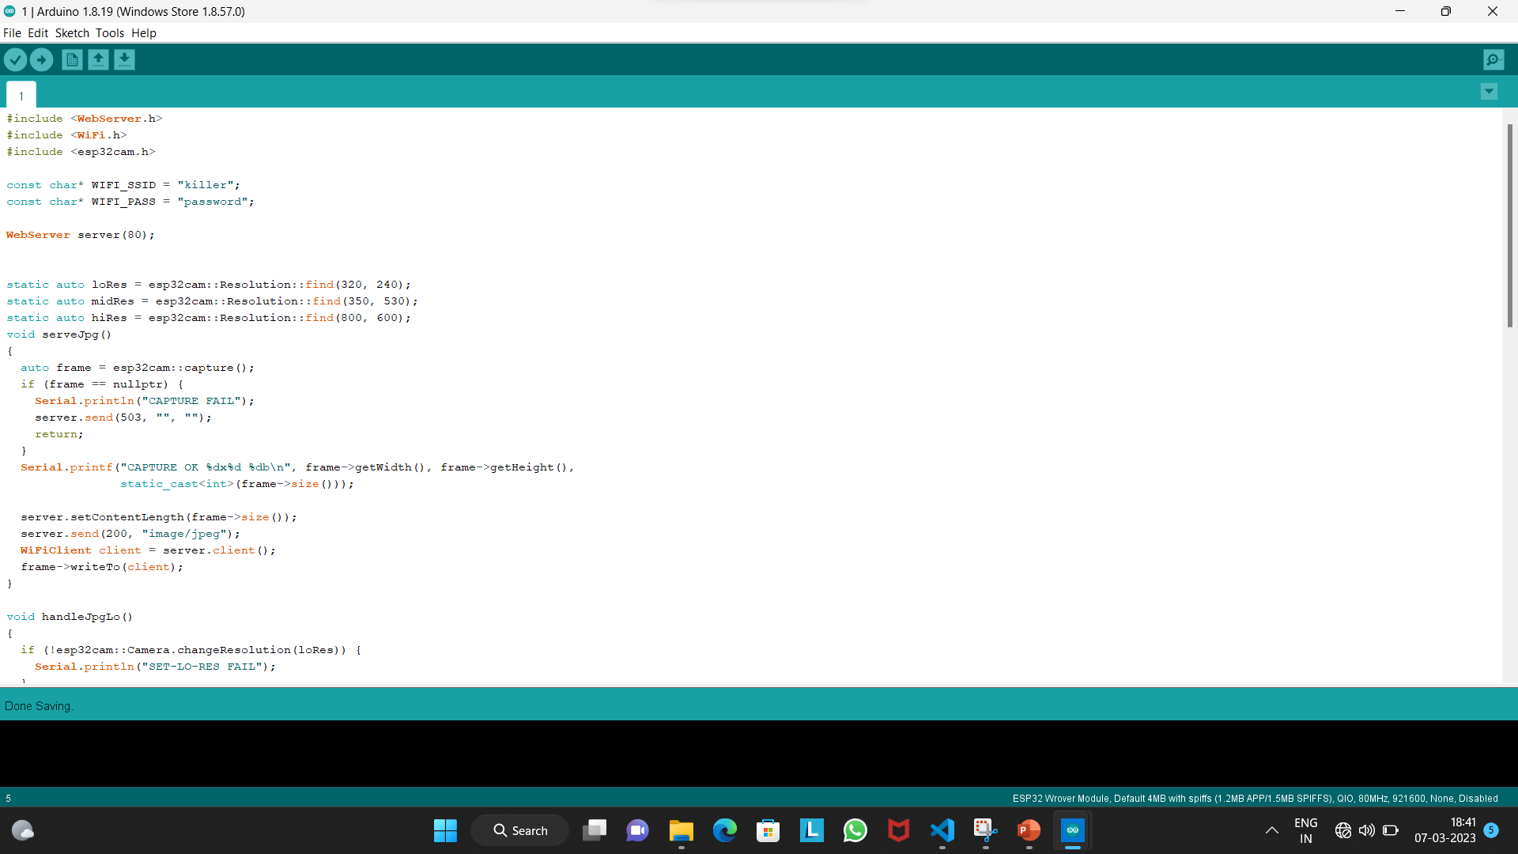
Program for ESP32-CAM

Slide 10

Python Code

Slide 11
APPLICATION
The face recognition attendance system automates attendance tracking by visually recognizing the person and registering his attendance
The employees or students need to show their faces to the camera of the attendance management system

Slide 12
FUTURE SCOPE
By using this technique we are going to develop the project with extra specification that includes:
SMS Notification
Other Members Entering to the section
Full details of the members

Slide 13
THANK YOU
ANY QUESTIONS:-

